Slide 1
Training & Orientation
Stonegate at Pasco HOA

Slide 2
About Envera Systems
Corporate Office located in Coconut Creek, Florida
Central Station is in Sarasota, Florida
Started in 2007 with 5 Employees
Now 200+ Employees
Hundreds of Years Experience in Security Industry
Envera Systems provides gated customers with an alternative to traditional guards. Our patented monitoring system and software utilize the latest technology combined with State Licensed Guards to offer an enhanced level of security, in a more efficient manner and at a lower cost. Our licensed central station operators or virtual guards greet guests arriving to Envera protected communities. They can also see multiple points in a community at one time, deterring trespassers and voicing down to intruders or vandals.

Slide 3
Community Security Specialists
Who do we Serve?
Homeowners Associations
Community Development Districts
Condominium Associations
Apartment Complexes
What do we do?
Gate Monitoring
Active Video Monitoring for Amenities & Parking Lots
Community Wide Access Control
Clubhouse Intrusion Systems
How do we do it?
Internet Based
Event Based Monitoring
Live Audio and Video
Two Way Voice
Real-Time Communication

Slide 4
MyEnvera: Adding Visitors http://enverasystems.com/myenveravideos/

Slide 5
MyEnvera: Profile Updates http://enverasystems.com/myenveravideos/

Slide 6
MyEnvera Smartphone App

Slide 7
Register Visitors

Slide 8
Manage Profile

Slide 9
Guest Registration

Slide 10
MyEnvera Questions & Answers
How/where do I find my MyEnvera login?
Your login was included in the resident letters we mailed out. If you did not receive a letter, please let us and your community representative know after the presentation.
If you forget your login and need to retrieve it, please go to MyEnvera.com and click on the Get your login information link.
Do I still call our onsite guard to update my visitor list?
Even though your onsite guard will be using Envera’s guard module software to process visitors, you will no longer call them to make updates to your guest list. You will use the MyEnvera website or Smartphone App, or you can call Envera’s toll free (877) 936-8372 for assistance.
Do I have to add my visitor’s license plate?
No, this is not a requirement; however, it will allow for expedited entry on their first visit. Otherwise our agents will add their license plate information to their visitor record on their first visit.

Slide 11
MyEnvera Questions & Answers
What if I have a vendor coming to my house but I don’t know the name of the representative that will be visiting?
When adding this household specific vendor to your visitor list, please enter the company name in both the Last Name & Company Name fields. This allows our agents to quickly search and find the vendor record.
What do I need to do if I am having a party?
On your Visitor List, create a Temporary visitor with *Admit All as the Last Name & the Type of party as the First Name
Example: *Admit All, Baby Shower
When will Resident Notifications be activated for our community?
These notifications will be turned on soon after the soft opening period is complete.
How many phone numbers can I add to my MyEnvera profile?
You can add unlimited phone numbers to your profile; however, we encourage you to only list those where the chance of us reaching you is most favorable.
Please be advised that our agents will be restricted to attempting only two phone numbers for visitor verification.

Slide 12
MyEnvera Questions & Answers
What if I do not want my child/teenager to authorize entry?
Not a problem. You can simply not add a phone number for your child/teenager or you can add your phone number for your child/teenager. Either way when a visitor comes to the kiosk stating they are here to see your child/teenager and they are not on your visitor list, we will contact you at the number(s) you have listed on your profile.
How do tenants add guests?
Tenants can also add guests online via the MyEnvera website or Smartphone App.
What do I need to do when I change tenants?
Complete a Resident Registration Form with new tenant information & submit to Property Manager with other required documents.

Slide 13
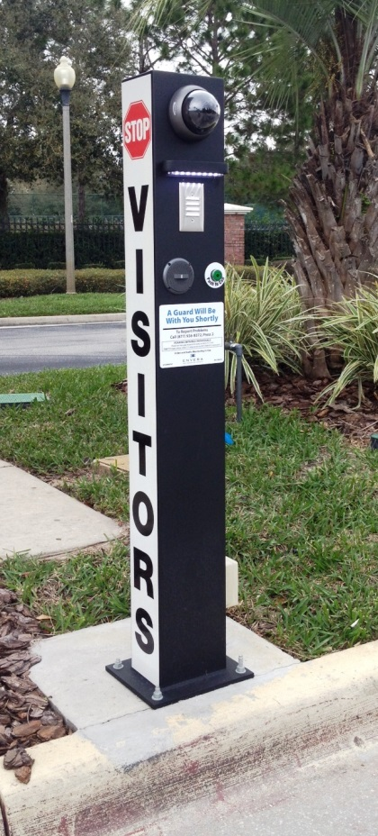
Virtual Gate Guard
Envera will control visitor & vendor entry at the Community Entrance
‘Virtual’ guards greet visitors 24/7
Class D Licensed
Capture and archive faces and license plates of each visitor with strategically placed cameras
Auto-verification of license plate for registered permanent visitors
Recorded audio and video of each accepted or denied visitor, archived for 30-45 days
Barrier gates to help mitigate tailgating
Gate strike sensors installed on all barrier arms to notify Central Station of potential gate break

Slide 14
Go Live “Soft Opening”
Targeting Tuesday, January 8th to Begin Processing Guests
All registered guests will be admitted into the community.
First week
Unregistered guests: Tag Plate & advise visitor to remind the resident to bring their guest list up to date & admit into the community.
Weeks 2 & 3
Unregistered guests: resident will be called for verification of visitor.
No Answer: Tag Plate & admit into the community.
Resident will be contacted on up to two phone numbers provided for approval.
Week 4
Unregistered guests: visitor will be denied access into the community if we cannot reach the resident for approval.

Slide 15
Virtual Gate Guard Questions & Answers
How will the Automatic License Plate Recognition work for entry?
The first time a registered visitor pulls up to the kiosk, one of our guards will process and attach the license plate to their profile.
As long as they remain a permanent visitor, all ongoing visits will be auto-verified by the system to grant entry.
Should a visitor be listed on multiple resident lists, or they are flagged as Deny, or they are removed as a permanent visitor, they will be routed to a guard for processing – the auto-verification will not occur.
What happens when a visitor is denied entry?
Our agent will advise “Unfortunately at this time I was unable to verify your entry, please pull around and once verification is received from the resident, we will be glad to assist you.”
Since there is no turnaround before the gate, our agent will advise “Unfortunately at this time I was unable to verify your entry, please enter through the gate and turnaround to exit. Your entry and exit is recorded on camera.”
When do I need to use my PIN?
Residents will provide their PIN to Envera when using the kiosk for entry or calling into the Central Station to update their profile.
If you don’t have your PIN, you will need to provide the last 4 digits of the phone number on the account.

Slide 16
Virtual Gate Guard Questions & Answers
What if there is damage to the barrier arm/swing gates?
When notified by gate strike alarm, Central Station will pull video + tag to provide to community.
If gate damage is observed, Central Station will contact community representative to have them fixed.
How do UPS, FedEx and other community vendors gain entry into the community?
Envera has been provided with a list of community approved vendors for the common areas. They will be admitted into the community with no issue.
This includes newspaper deliveries.
How do emergency vehicles gain access into the community?
We determine the required emergency device(s) with the municipality and if not already installed, we will install or coordinate with the community to have the device(s) installed. We schedule inspections to ensure proper operation of the device(s).
What if there is loss of power to the gates?
Per Fire Code, the gates will fail open.

Slide 17
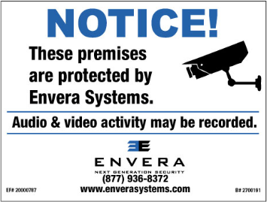
Active Video Surveillance
Envera is monitoring your Pool after hours
Live video as alarm received
Live 2-way audio with “voice down” capability
Police dispatched as necessary
Heightened security
Reduces vandalism & trespassing

Slide 18
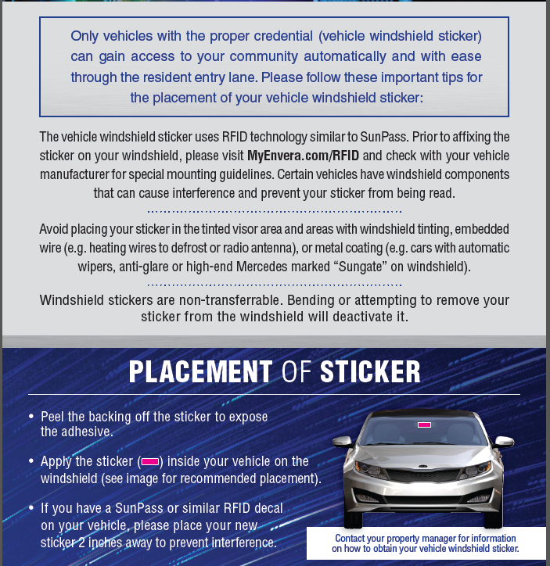
How to Apply Your Windshield Sticker
Visit www.myenvera.com/RFID and check with your vehicle manufacturer to see if you have a special windshield
Place at least 2 inches away from SunPass or other RFID device
Non-transferrable, do not bend
Peel backing off to expose adhesive side
Apply inside your vehicle, directly on windshield

Slide 19
Association Requirements
To receive windshield stickers, residents must provide:
Provide a valid photo id
Copy of vehicle registration for each vehicle onsite
Proof of residency (tenants: copy of lease)
Distribution Details:
Each household is eligible to receive up to (2) two windshield stickers at no charge.
Additional windshield stickers are $15.00 each
Accepted payment method is Check or Money Order only (made payable to Stonegate at Pasco HOA).

